Slide 1
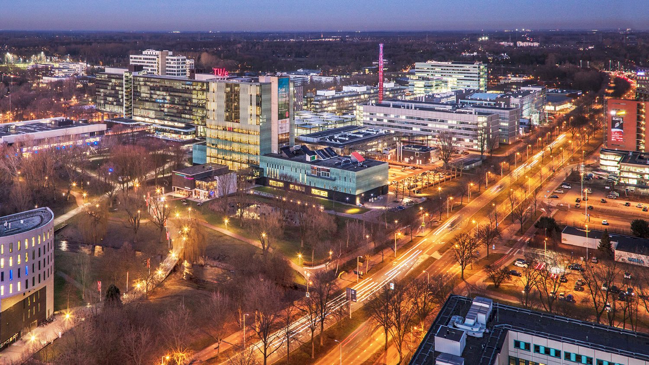
Transfer Learning in Cone-Beam CT Artifact Reduction
17.12.2020
Florian Delberghe
Department of Biomedical Engineering, IMAG/e

Slide 2
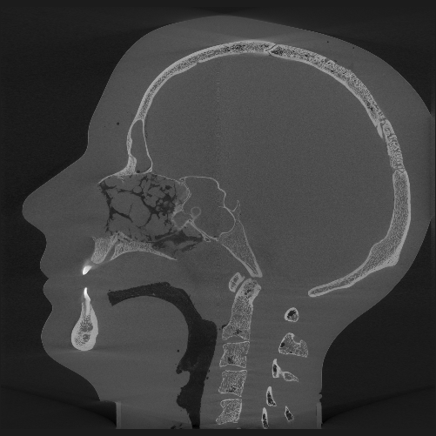
Data Acquisition & Processing

Slide 3
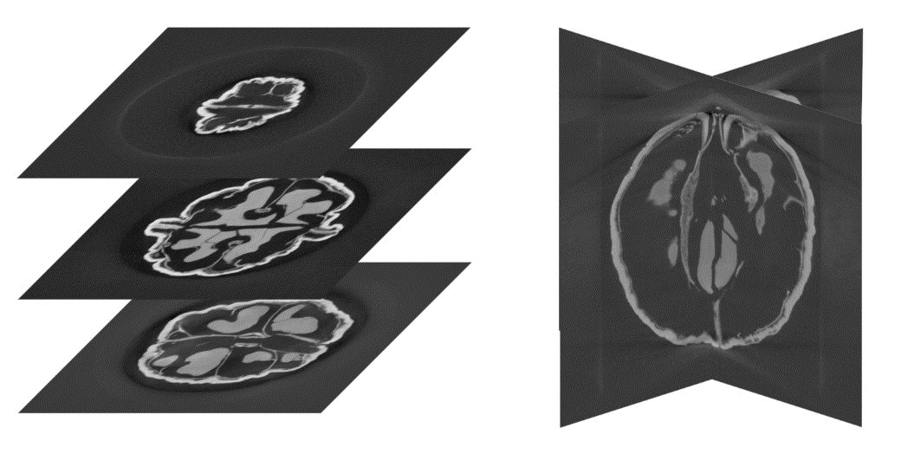
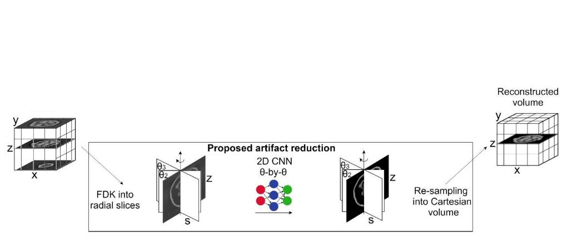
Radial Sampling on Walnuts
Axial to Radial Sampling

Slide 4
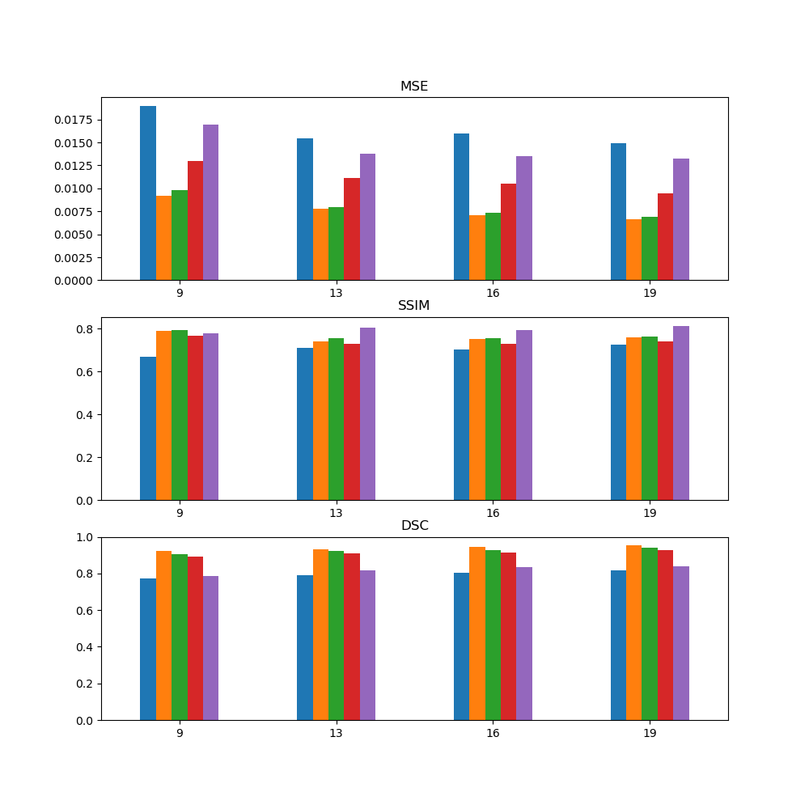
Simulation of Artificial Cone-Beam Scans
Using real scanning trajectories, simulate CBCT scans:
Compare diff between true and sim
Diff wrt max delta true/sim

Slide 5
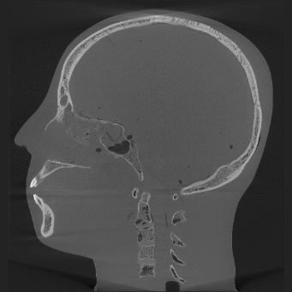
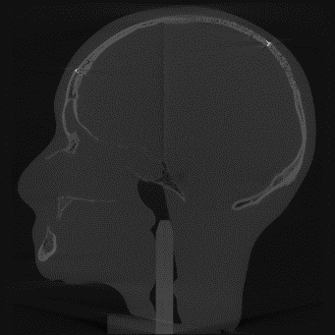
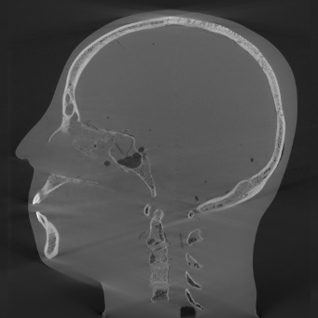
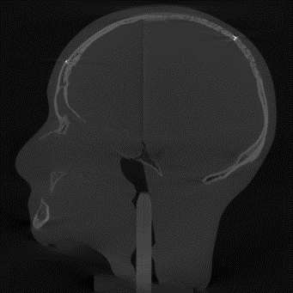
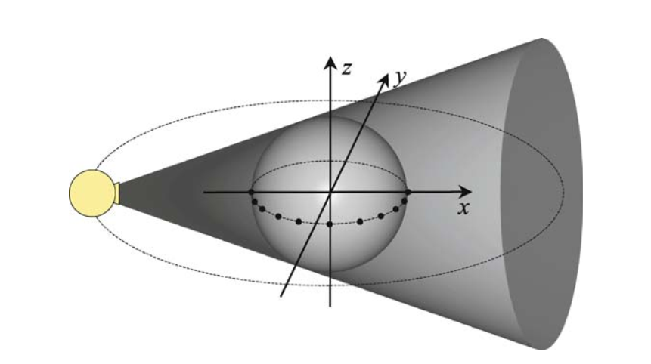

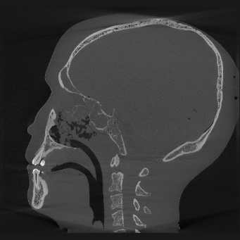
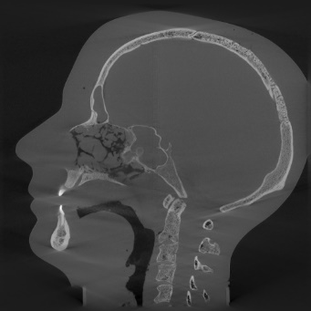

Simulation on Anthropomorphic Phantoms
1
6
3
7

Slide 6
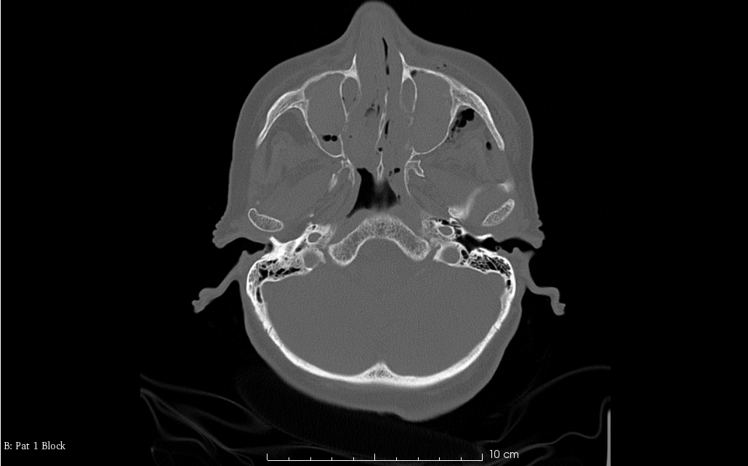
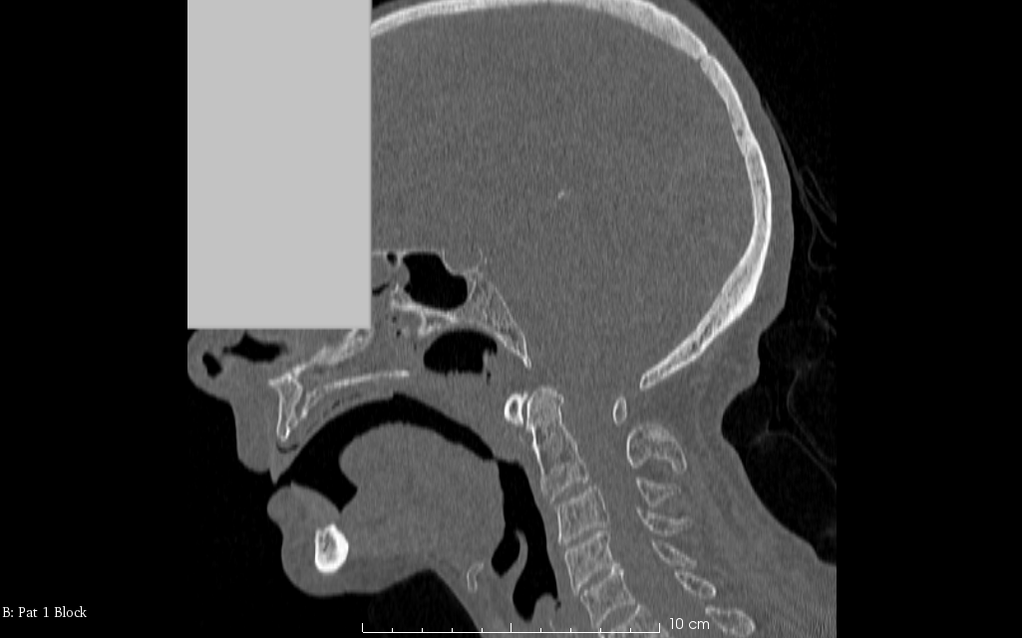
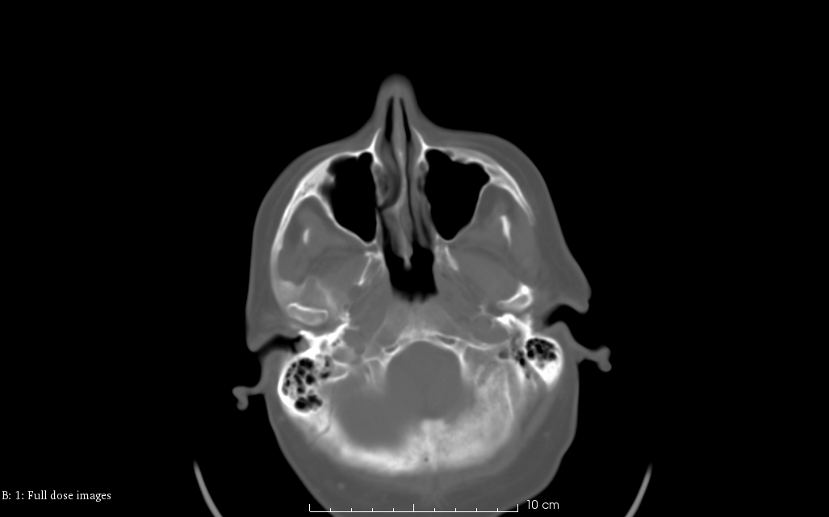
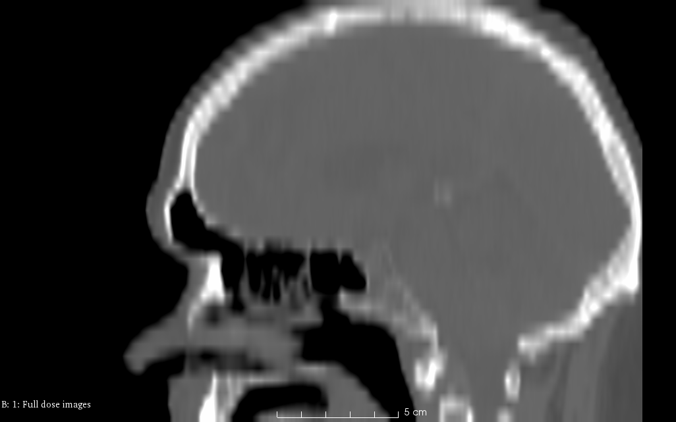
Open Dataset(s) …
[1]
[2]
Notes:
1. Mandibular CT Dataset, https://figshare.com/articles/Mandibular_CT_Dataset_Collection/6167726/5
2. LDCT Dataset, https://wiki.cancerimagingarchive.net/pages/viewpage.action?pageId=52758026

Slide 7
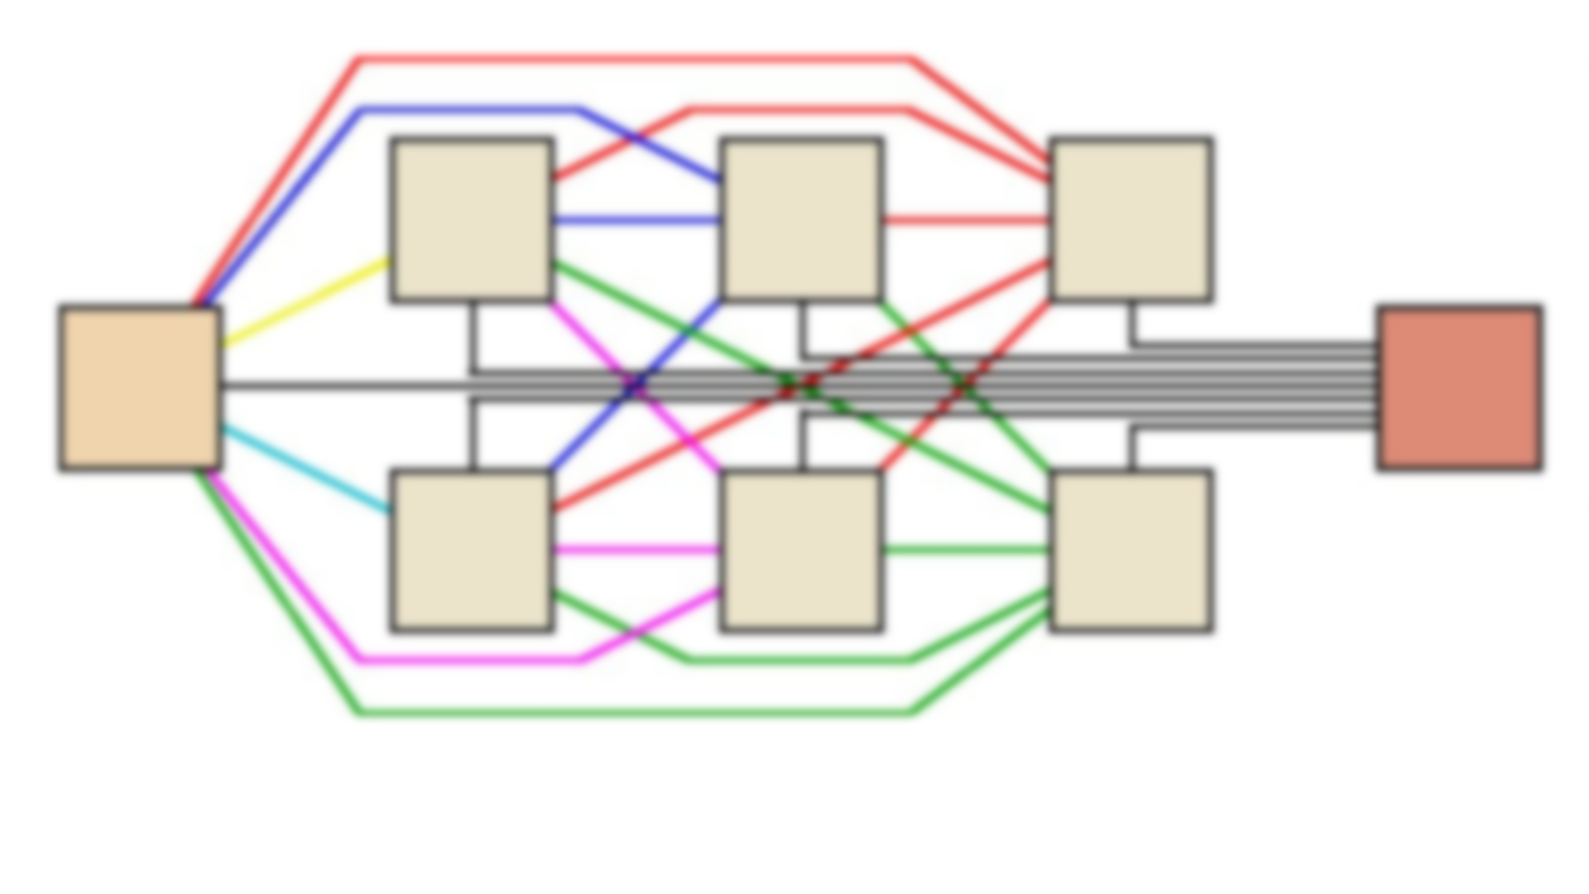
Pre-training on Walnuts

Slide 8
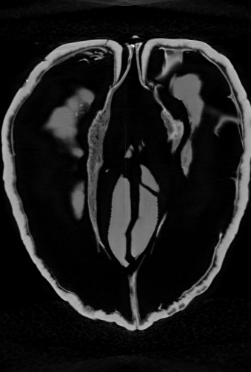
Training Setup for Pre-trained Models
Train shallower 30 layers MSD
Training w/ 3 orbits (90k images, 30k targets)
Fast Radial Sampling
Exponential LR decrease (x0.01)
50 epochs
Flipping along vertical/horizontal axes

Slide 9
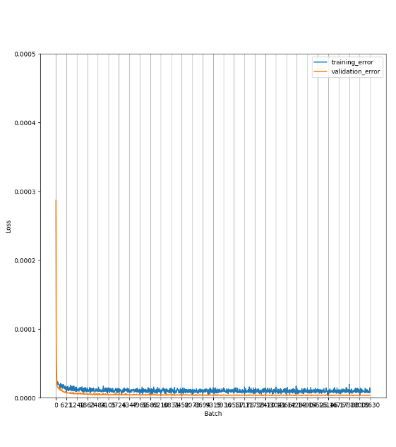
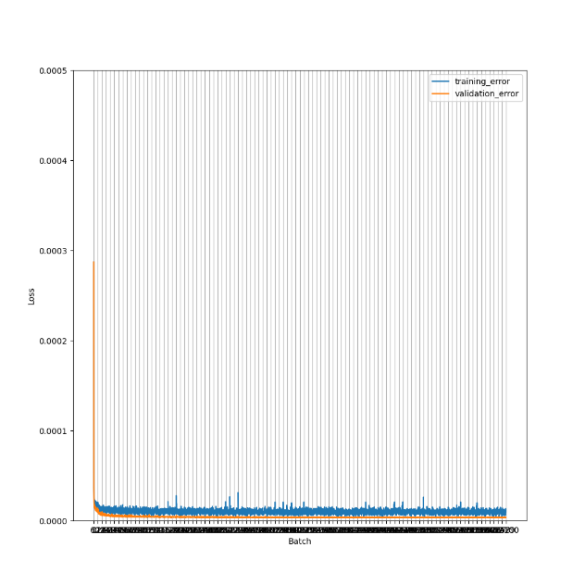
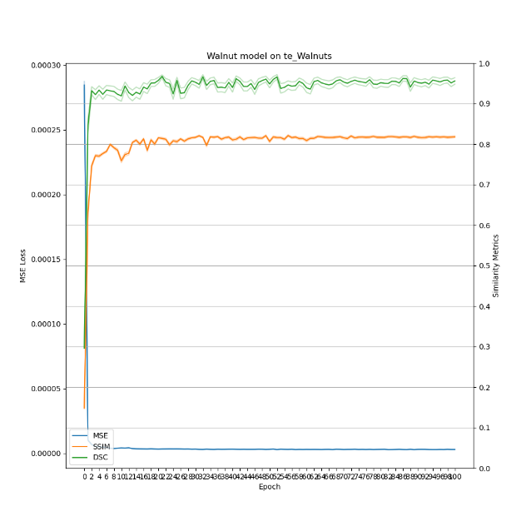
Training Setup for Pre-trained Models
Normal training
2x epochs
Metrics convergence

Slide 10
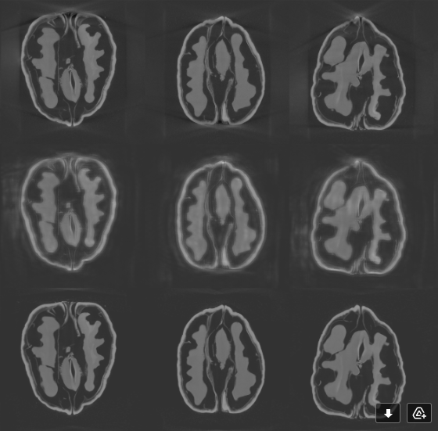
Eval-time Discrepancies
Some remaining issues with MSD
Different behavior depending on the machine
WIP…

Slide 11

Transfer Learning

Slide 12
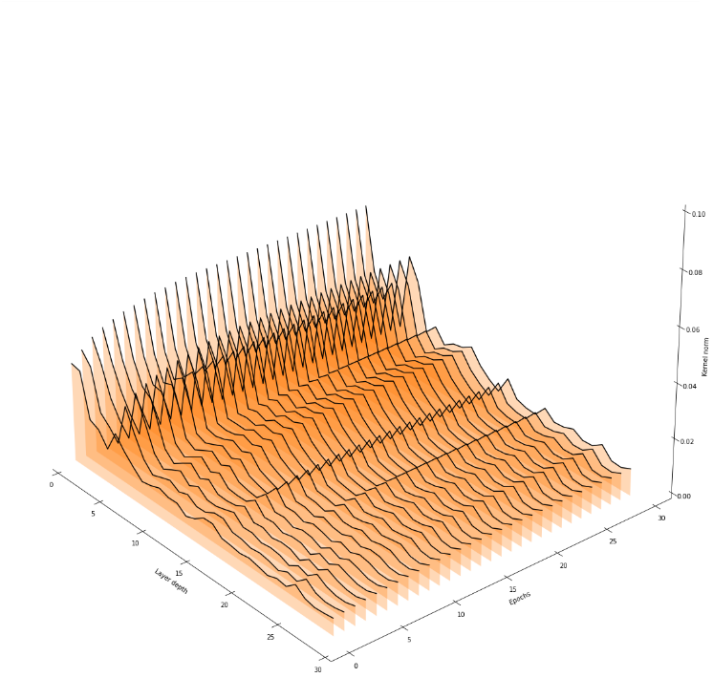
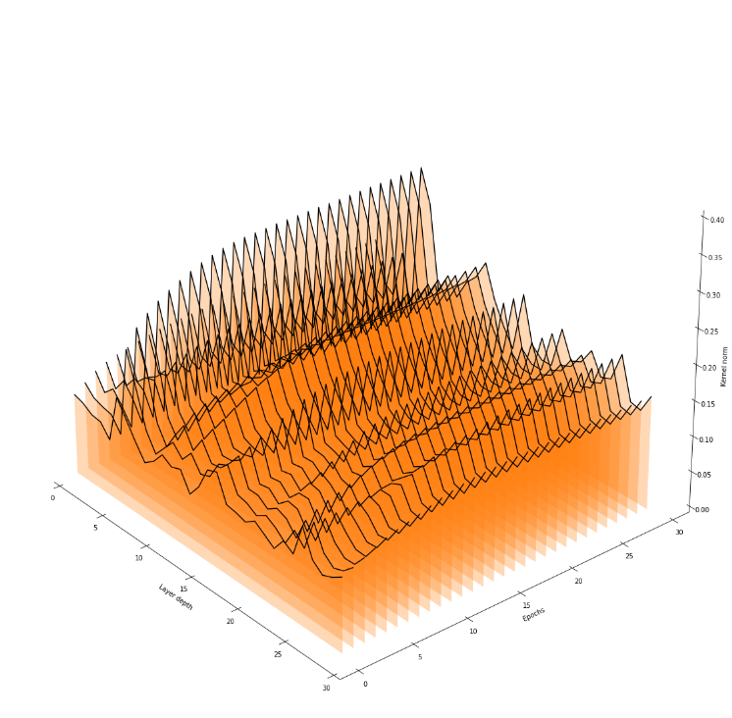
Layer norm, Scratch Walnut Training
Layer std, Scratch Walnut Learning

Slide 13
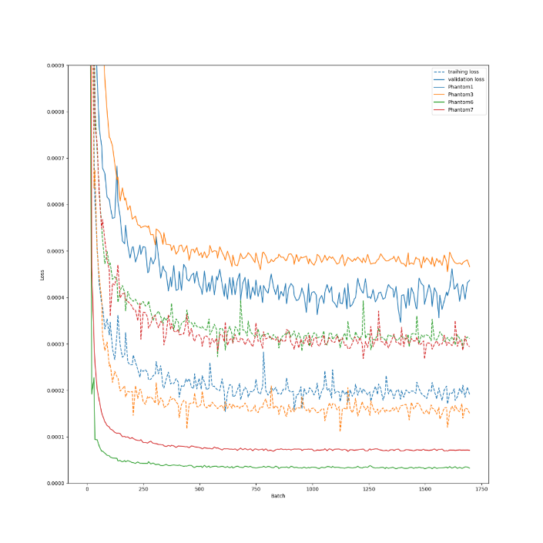
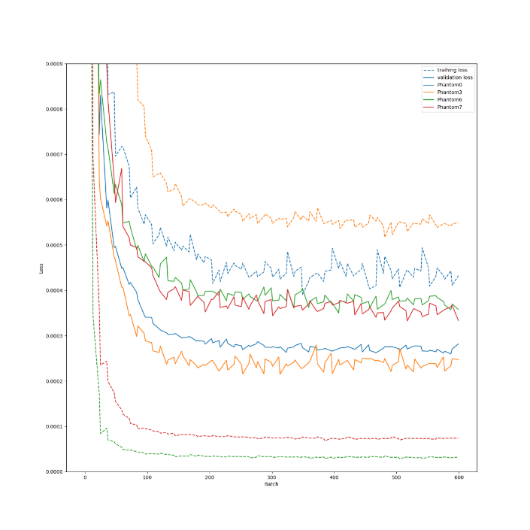
LOICV
LOOCV

Slide 14
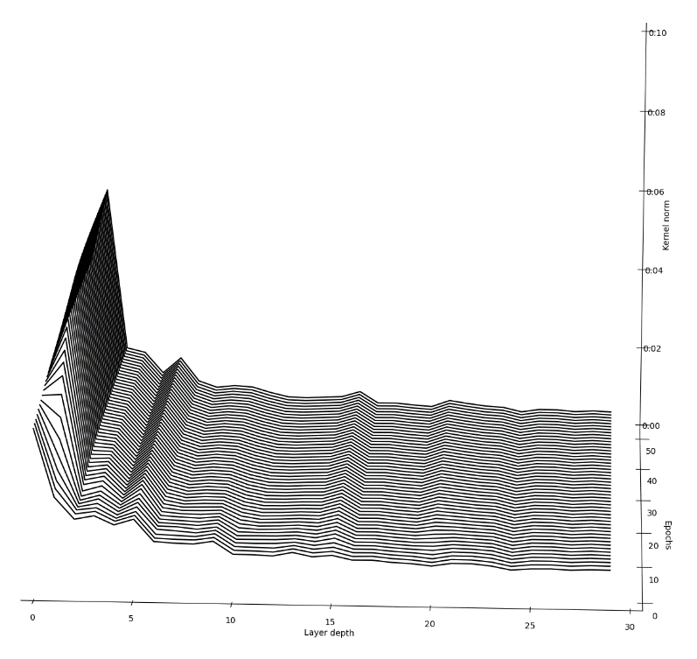
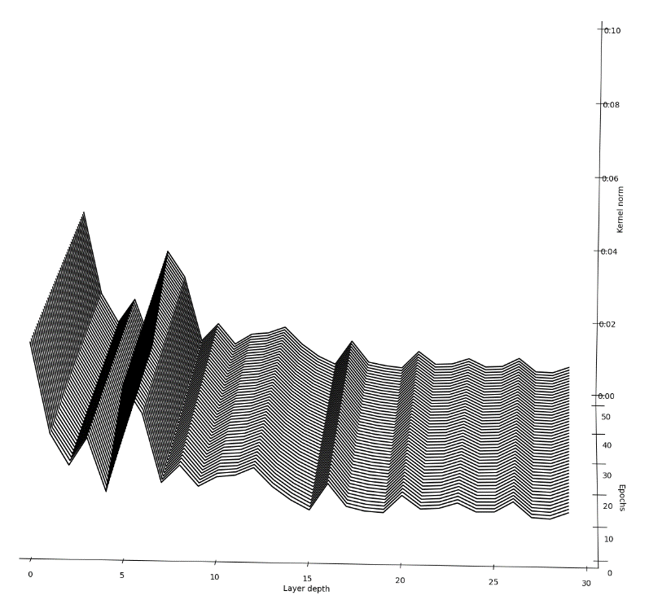
Layer Norm, Scratch Training
Layer Norm, Transfer Learning

Slide 15
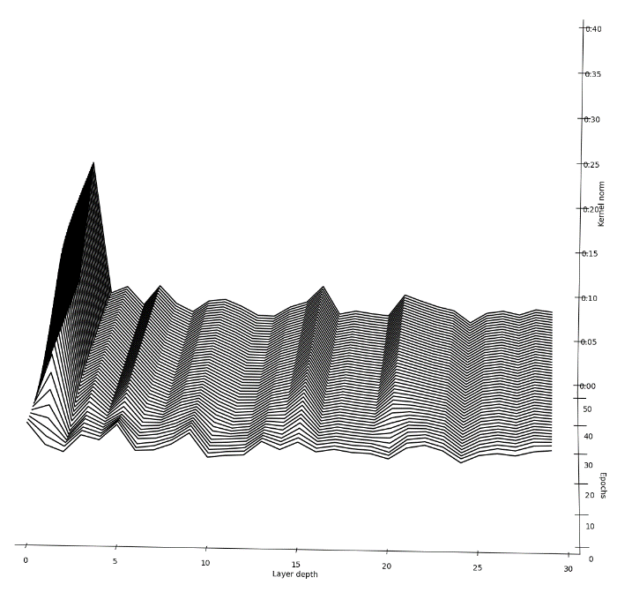
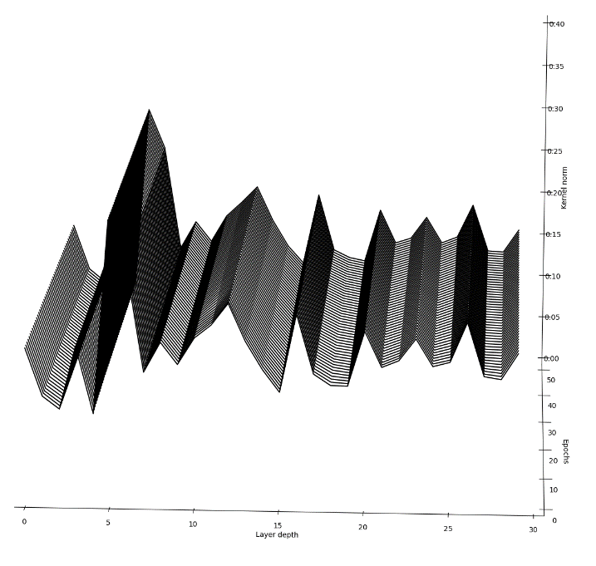
Kernel std

Slide 16
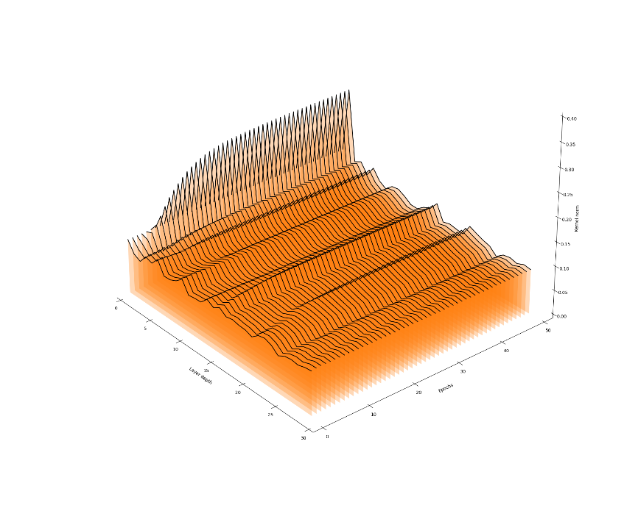
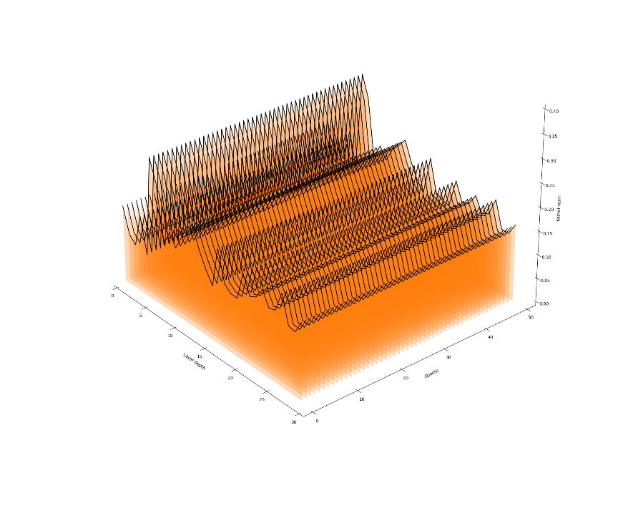
Layer std, Scratch Training
Layer std, Transfer Learning

Slide 17
Effects of dataset size
Effects of dataset size
Isolate 1 sample for final testing
Train on 1-3 sample and evaluate perf on the test set
Cross testing? (since perf are phantom dependant)

Slide 18
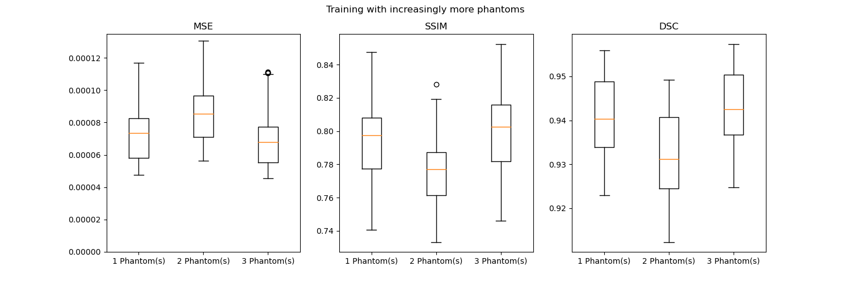
Effects of dataset size (scratch)

Slide 19
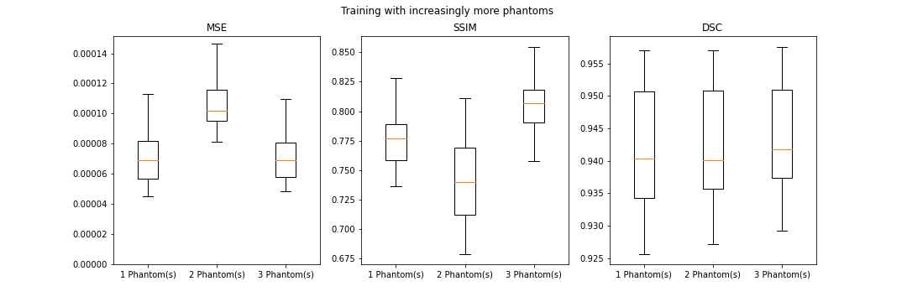
Effects of dataset size (transfer)

Slide 20
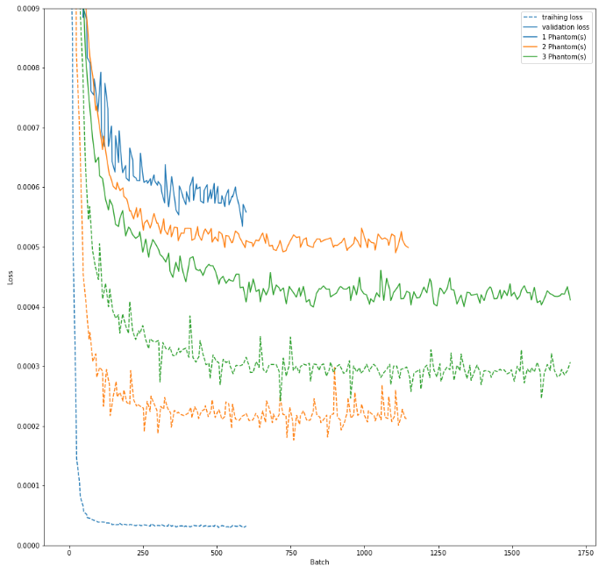
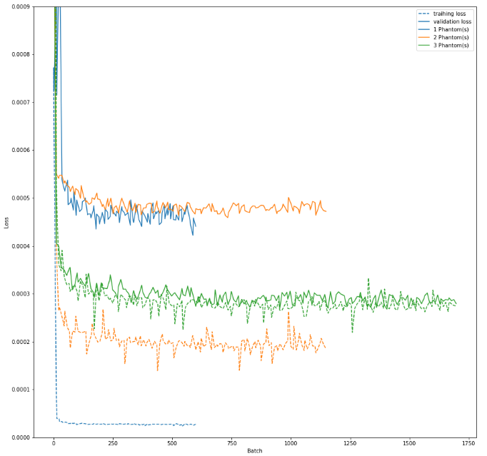
Scratch Learning
Transfer

Slide 22
Logo – Dual branding: partnership logo’s
Within the logo system of TU/e, collaborations with strategic partners can be expressed in a ‘Partnership logo’. It is a form of dual branding in which the logos of the partner and TU/e are placed next to each other. The partnership logo is designed according to the following guidelines:
The TU/e logo is positioned in the bottom right-hand corner of the slide. The partner’s logo is placed next to it with a minimum margin of 0,35 cm.
It is preferable to use a monochrome version of the partner’s logo for this purpose.
The TU/e logo is colored using the ‘Coloring principle’. This means that the background of the boxed TU/e logo takes on the (most dominant) color of the partner logo.
The color specifications of the partner’s house style guidelines determine the correct coloring of the TU/e logo.
You can also use the Eyedropper Tool in PowerPoint. Match the color of the partner’s logo with the background of the boxed TU/e logo.

Slide 23
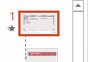
Dual branding: partnership logo’s
Open Masterslide (Beeld / View -> Diamodel / Master)
Select the first Master at the top
Right-click example logo and choose Afbeelding wijzigen / Change Image …
Browse for the partner logo
Select the partner logo, click tab Opmaak / Format, click Kleur / Color-pulldown, next Meer variaties / More variations, and select Pipet / Eyedropper
Select the (most dominant) color of the partner logo
Right-click the TU/e logo and choose Afbeelding opmaken … / Format Image …
Use Opvulling / Filling -> Opvulling, effen / Filling, solid -> Kleur / Color pulldown and next choose the first color from the Recente kleuren / Recent colors
Close Masterslide to return to the slides

